Slide 1
Constructor Injection with Map having Dependent Object
We can inject the dependency by constructor.
The <constructor-arg> sub-element of <bean> is used for constructor injection.
We can inject
primitive and String-based values
Dependent object (contained object)
Collection values etc.
Map

Slide 2
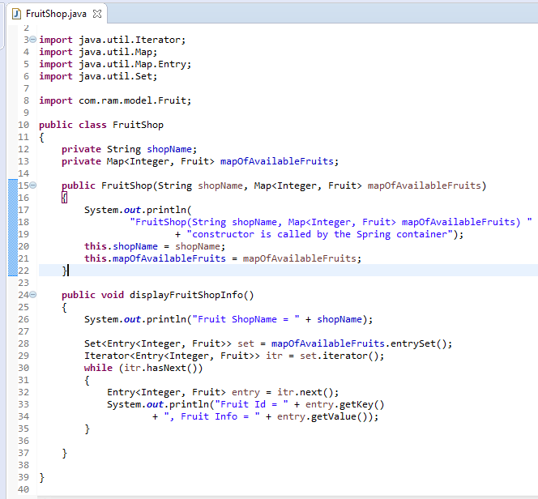
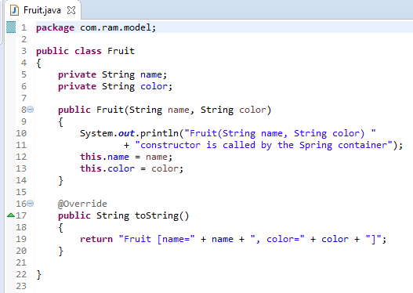
Constructor Injection with Map having Dependent Object

Slide 3
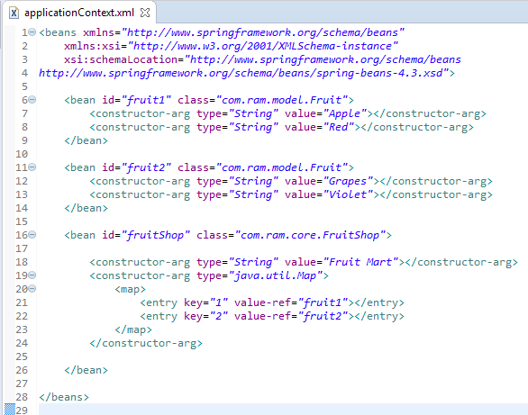
Constructor Injection with Map having Dependent Object
We are providing the information into the bean by applicationContext.xml file.
The constructor-arg element invokes the constructor.The type attributes specifies that String, Set parameter constructor will be invoked. In this example FruitShop(String shopName, Set<Fruit> setOfAvailableFruits) constructor will be invoked.
The set element of constructor-arg is used here to define the set.

Slide 4
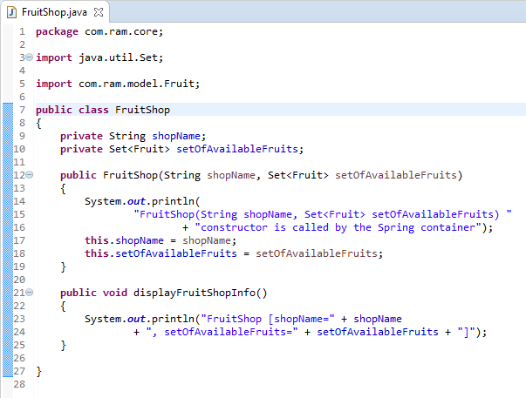
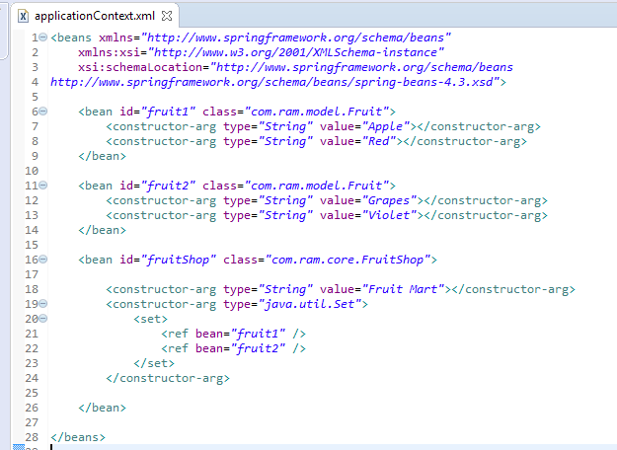
Constructor Injection with Map having Dependent Object
FruitShop
What object to instantiate?
What object to configure and how to configure?
The Spring Container
(ApplicationContext)
applicationContext.xml
FruitShop
Object
shopName=Fruit Mart,
listOfAvailableFruits=
[Fruit [name=Apple, color=Red],
Fruit [name=Grapes, color=Violet]]
Create the FruitShop object.
Configure the FruitShop object.
Manage FruitShop object complete life cycle from creation till destruction.

Slide 5
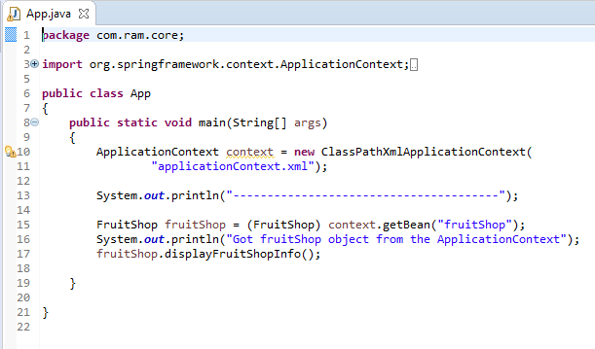
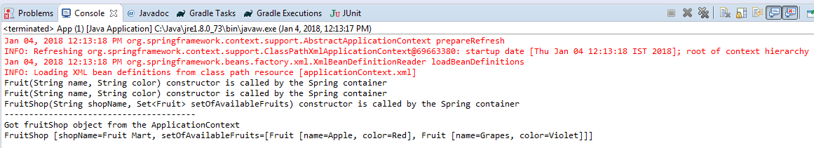
Constructor Injection with Map having Dependent Object

